Slide 1
BINDT FMC User group
Update of BINDT FMC User Group
Tom Bertenshaw (GKN Aerospace)
09/04/2019

Slide 2
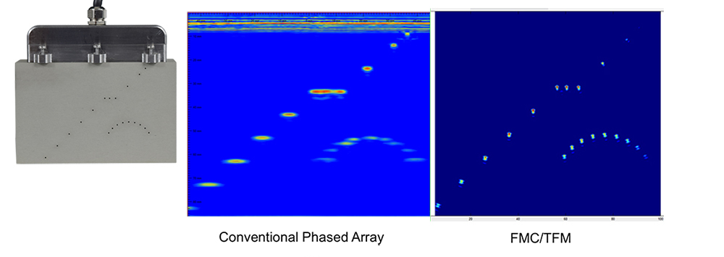
BINDT FMC User group
Introduction: What is FMC/TFM?
FMC/TFM are often described together. However, the distinction between the two are as follows:
FMC relates to Data acquisition. Often parallel channel systems are utilised, with high speed connections to the CPU or GPU used to do the data processing.
TFM relates to Data re-processing. Currently, this is always done in software.
FMC – Full Matrix Capture
TFM – Total Focusing Method
PAUT – Phased Array Ultrasonic Techniques
Image courtesy of The Phased Array Company (TPAC)
Notes:
There are other array imaging techniques, which include:
VSA – Virtual Source aperture
HMC – Half Matrix Capture
IWEX – Inverse Matrix Field
SMC – Sparse Matrix Capture
SPA – Sampling Phased Array

Slide 3
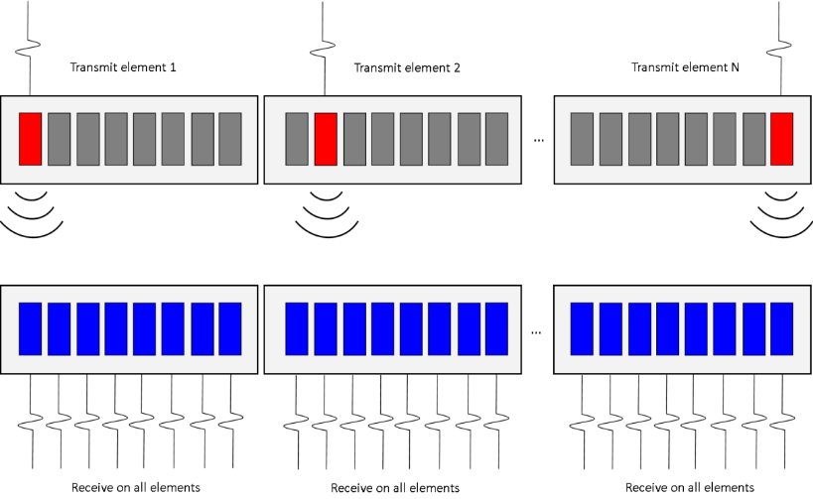
BINDT FMC User group
Introduction: How does it work?
All elements receive ultrasound signal at different times
Send on probe element 1
Send on probe element 2
Send on probe last element
Receive on all elements
Receive on all elements
Receive on all elements

Slide 4
BINDT FMC User group
Benefits & Drawbacks from FMC/TFM
Aspect | PAUT | FMC/TFM | Cases for FMC/TFM
Focusing | Beams are limited in focusing to a depth (dependant on focal law) | All points in the Region of interest can be focused | Sizing flaw during testing is more accurate
Relative insensitivity to incident angle of flaws | Transmitted beams have defined directions - response is dependent on angle of incidence | Since image is created from multiple transmit receive paths, there is less sensitivity on orientation of the reflector | Improved detection of directional flaws
Dead Zone | Dead zones similar to all PE testing where receive direction is similar to transmit direction | Receive path spread over a much larger area of front wall leads to smaller dead zones. | Detection of flaws close to scanning surface/improved inspectability of smaller parts
Data File size | Data file sizes similar to conventional UT | Data file sizes are orders of magnitude larger than PAUT | Limitation can be negated once processing technology improves
Instrumentation / Equipment | Equipment generally makes use of multiplexers so more elements can be used | Parallel channel system needed to address full receive on all probe elements | More platforms are now available which address this limitation.

Slide 5
BINDT FMC User group
Aims of the FMC User Group:
Build profile and awareness of FMC/TFM in the NDT industry
Develop Common file format
Terminology
Calibration

Slide 6
BINDT FMC User group
Group members & Applications:
FMC Applications
Weld (steel) Inspection
Additively Manufactured parts
Concrete testing
Corrosion mapping
Hydrogen damage in steel components (e.g. HTHA)
Cast austenitic stainless steel
Zirconium niobium pressure tubes
Composite Material inspection
OPG
Zetec
Sonomatic
GKN Aerospace
PEAK NDT
Proceq
Eddyfi
Baker Hughes (GE)
Sound Mathematics
AOS/TPAC
Dolphitech
TWI
Applus RTD
Olympus
Notes:
Very few end users are attending
Many others have acknowledged that they are interested, but are keeping a watching brief on the topic
So far, most of the development has been driven from the equipment providers.
Majority of development has been on weld inspection

Slide 7
BINDT FMC User group
Standards & Codes:
ASME has formed a group
IIW has formed a group that has created 2 documents for weld inspection
R9FM-V-1818-18: FMC-TFM – General use of Full Matrix Capture
R3FM V 1819-18: FMC-TFM for weld Testing
These documents have been assigned as work items by ISO (approval will take 2-3 years)
Notes:
Most of the attendees from these groups are from equipment providers

Slide 8
BINDT FMC User group
Other modes of inspection
There are other modes in which FMC / TFM can be constructed
Transverse as well as longitudinal wave modes can be considered. Each wave mode has it’s strength when it comes to flaws orientated at other angles
Total Path / TFM type / Inspection type |  | Description
 | T-T L-L | Transmitter path direct, receiver path direct
 | T-TT,TT-T LL-L, L-LL LT-T, T-TL TT-L, L-TT | Transmitter path direct, receiver path indirect, or Transmitter path indirect, receiver path direct
 | TT-TT, LL-LL, TL-LT | Transmitter path indirect, receiver path indirect
 | T-T L-L | Transmitter path direct, receiver path direct
 | TT-TT, LL-LL, TL-LT | Transmitter path indirect, receiver path indirect
Notes:
All these different modes of inspection have their strengths and weaknesses for imaging different

Slide 9
BINDT FMC User group
Future activities of the group
Progress common file format
Create list of Needs for FMC/TFM Calibration
Promote the Group
More end users to steer technology to potential applications
Training & Examination material for the technology?
Notes:
Very little Aerospace participation!

